Slide 1
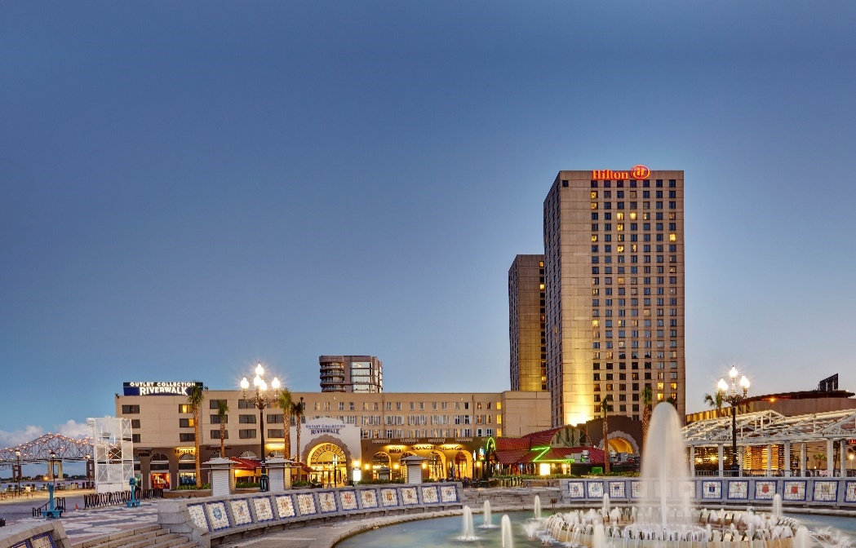

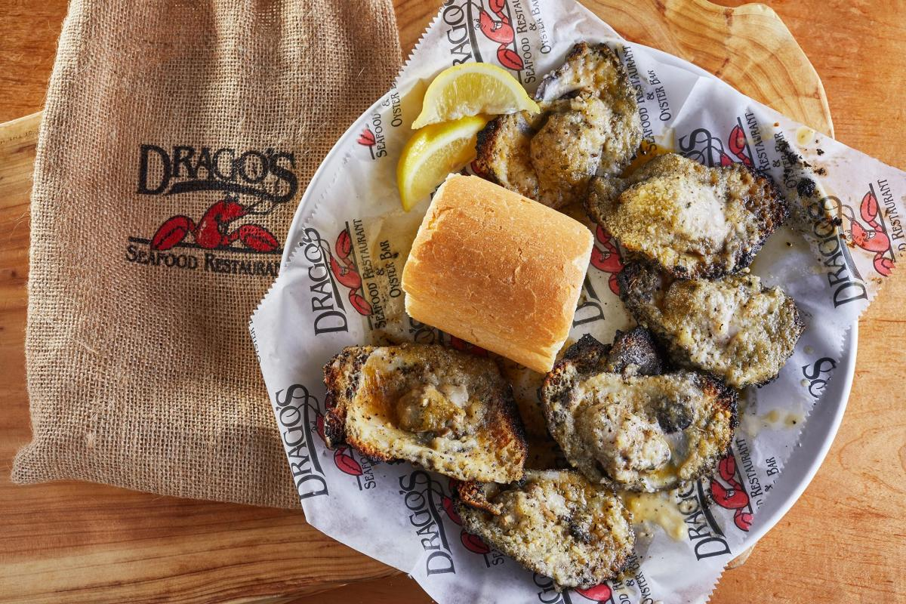


Career Opportunities at Hilton New Orleans Riverside
Drago’s Food Runner – FT/PT
Drago’s Bartender – PT
Drago’s Expeditor
Pastry Jr. Sous Chef
Pastry Cook
Banquet Lead Cook
Banquet Server - FT/On-Call
Banquet Bartender (On-Call)
Guest Service Agent
Guest Service Supervisor
Bell Captain
Housekeeping Houseperson
Laundry Attendant
Lobby Attendant
Spirits Bartender
Spirits Server - PT
Drago’s Cook
Spirits Cook
Food & Beverage Outlet Supervisor
Le Croissant Server
Le Croissant Buffet Attendant – FT/PT
Riverblends Barista-FT/PT
Banquet Houseperson – PT
Banquet Houseperson Supervisor
2nd Class Operating Engineer
Room Service Busperson – FT/PT
Steward – FT/PT
Group Housing Coordinator – FT/PT
Engineering Coordinator
AP Analyst/Staff Accountant
Security Officer
Hourly Openings
Management Openings
Banquet Manager
Banquet Senior Chef
Banquet Sous Chef
Chef De Cuisine
Executive Steward
Event Manager
Event Services Manager
Human Resources Manager (Team Member Engagement & Development)
EOE, including disability/vets
JOBS.HILTON.COM
02.10.23

